Slide 1


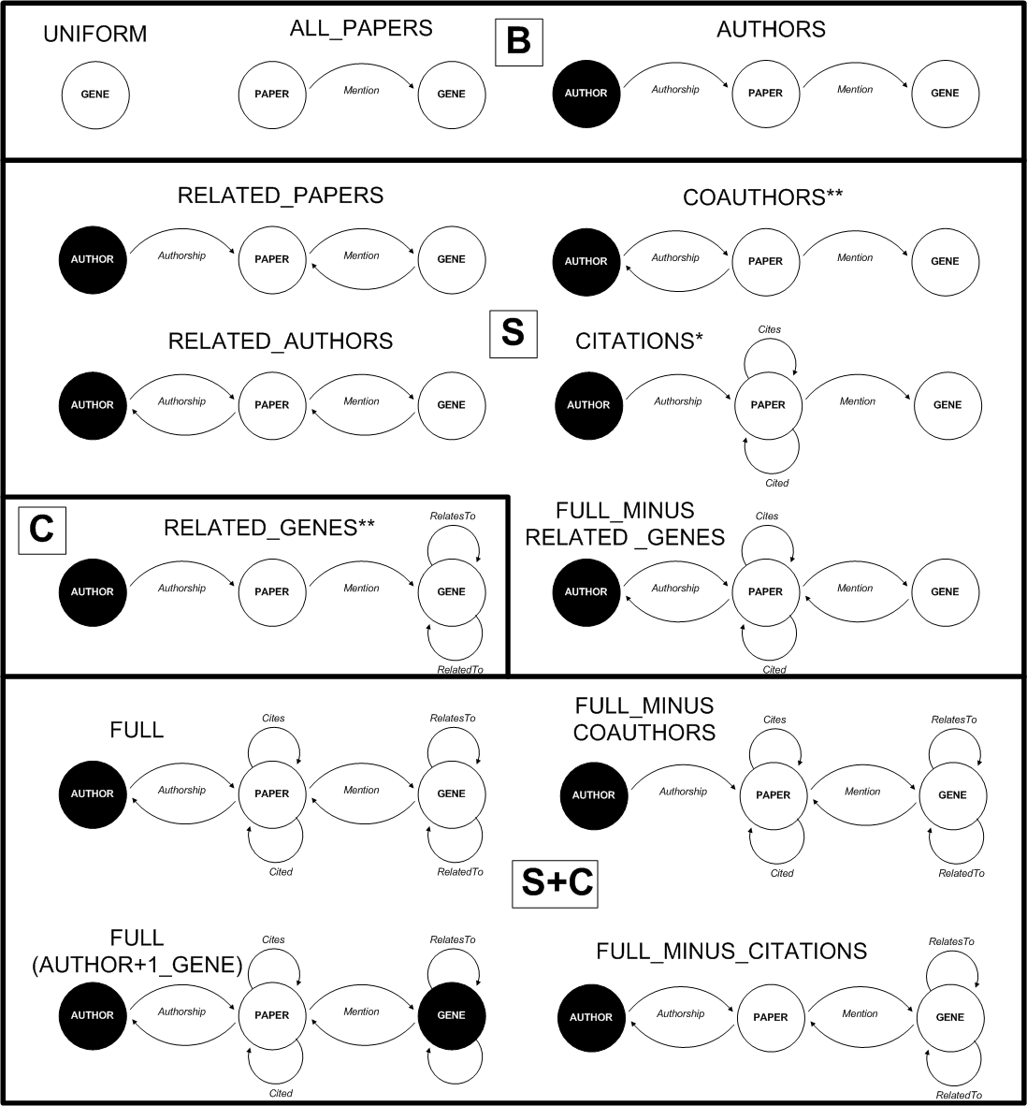
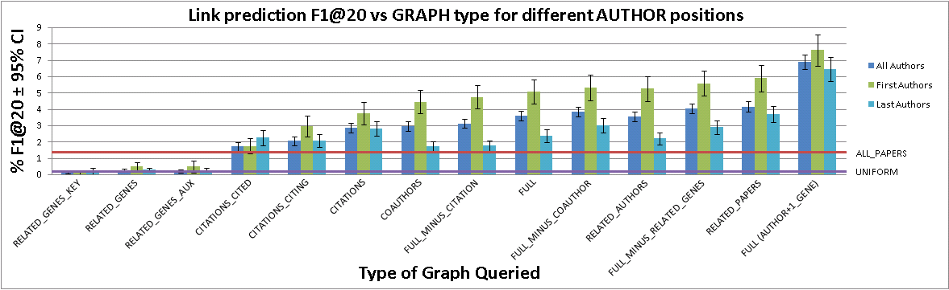
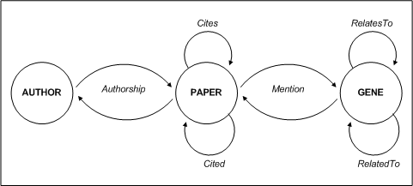
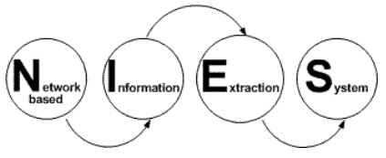
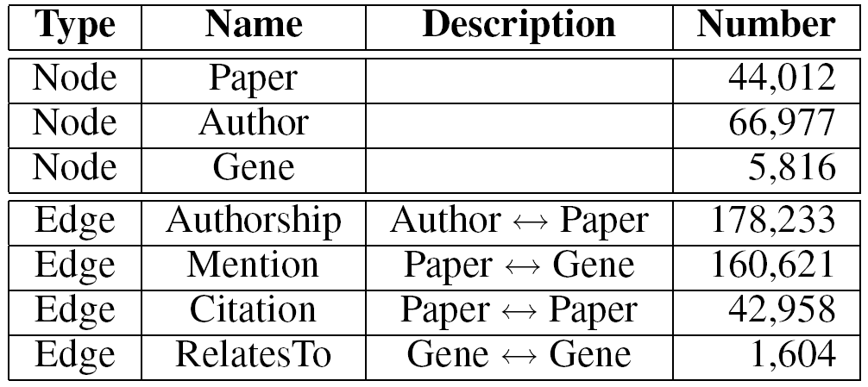
Information Extraction as Link Prediction:
Using Curated Citation Networks to Improve Gene Detection
Andrew Arnold and William W. Cohen
Machine Learning Department, Carnegie Mellon University
Introduction
Data
Experiment
Social networks, in the form of bibliographies and citations, have long been an integral part of the scientific process.
We examine how to leverage the information contained within these publication networks, along with information concerning the individual publications themselves and a user’s history, to help predict which entities the user might be most interested in and thus intelligently guide his search.
Our application domain is the task of predicting which genes and proteins a biologist is likely to write about in the future. We represent this as a link prediction problem wherein we predict which nodes in a graph, currently unlinked, “should” be linked to each other, where “should” is defined in some application-specific way. In our setting, we seek to discover edges between authors and genes, indicating genes about which an author has yet to write, but which he may be interested in.
We are able to extract the nodes and edges that make up our annotated citation network from the following data sources:
  PubMed and PubMed Central (PMC): PubMed is a free, open-access on-line archive of over 18 million biological abstracts and bibliographies, including citations, for papers published since 1948 [1]. PubMed Central contains full-text copies of over one million of these papers for which open-access has been granted [2].
  The Saccharomyces Genome Database (SGD): A database of various types of information concerning the yeast organism Saccharomyces cerevisiae, including descriptions of its genes along with over 40,000 papers manually tagged with the genes they mention [3].
  The Gene Ontology (GO): A large ontology describing the properties of and relationships between various biological entities across numerous organisms [4].
Nodes
The nodes of our network represent the entities we are interested in:
  44,012 Papers contained in SGD for which PMC bibliographic data is available.
  66,977 Authors of those papers, parsed from the PMC citation data. Each author’s position in the paper’s citation (i.e. first author, last author, etc.) is also recorded.
  5,816 Genes of yeast, mentioned in those papers.
Edges
We likewise use the edges of our network to represent the relationships between and among the nodes, or entities.
  Authorship: 178,233 bi-directional edges linking author nodes and the nodes of the papers they authored.
  Mention: 160,621 bi-directional edges linking paper nodes and the genes they discuss.
  Cites: 42,958 uni-directional edges linking nodes of citing papers to the nodes of the papers they cite.
  Cited: 42,958 uni-directional edges linking nodes of cited papers to the nodes of the papers that cite them
  RelatesTo: 1,604 uni-directional edges linking gene nodes to the nodes of other genes appearing in their GO description.
  RelatedTo: 1,604 uni-directional edges linking gene nodes to the nodes of other genes in whose GO description they appear.
Given our graph representation, the first step is to pick a set of query nodes to which our predicted links will connect. We then perform a random walk out from the query node(s), simultaneously following each edge to the adjacent nodes with a probability proportional to the inverse of the total number of adjacent nodes [5]. We repeat this process a number of times, each time spreading our probability of being on any particular node, given we began on the query node(s).
After each step in our walk we have a probability distribution over all the nodes of the graph, representing the likelihood of a walker, beginning at the query node(s) and randomly following outbound edges in the way described, of being on that particular node. We can then use this distribution to rank all the nodes, predicting that the nodes most likely to appear in the walk are also the nodes to which the query node(s) should most likely connect.
In order to evaluate our predicted edges, we can hide certain instances of edges, perform a walk, and compare the predicted edges to the actual withheld ones. We use ablation studies to assess the specific contribution of particular edge types.
Model
Subgraphs queried in the ablation experiment, grouped by type: B for baselines, S for social networks, C for networks conveying biological content, and S+C for networks making use of both social and biological information. Shaded nodes represent the node type(s) used as a query.
Curated citation networks
We construct a citation network as a graph in which publications and authors are represented as nodes, with bidirectional authorship edges linking authors and papers, and uni-directional citation edges linking papers to other papers (the direction of the edge denoting which paper is doing the citing and which is being cited).
We use curated literature databases for biology in which publications are tagged, or manually labeled, with the genes with which they are concerned. This allows us to introduce gene nodes to our enhanced citation network, which are bidirectionally linked to the papers in which they are tagged.
Finally, we exploit a third source of data, namely biological domain expertise in the form of ontologies and databases of facts concerning these genes, to create association edges between genes which have been shown to relate to each other in various ways. We call the entire structure an annotated citation network.
Results
Mean percent F1 @20 of queries across graph types, broken down by author position, shown with error bars demarking the 95% confidence interval, along with baselines UNIFORM and ALL_PAPERS.
Demo
Bibliography
U.S. National Library of Medicine. 2008. http://ncbi.nlm.nih.gov/pubmed.
National Institutes of Health. 2008. http://pubmedcentral.nih.gov
Dwight et al. 2004. Saccharomyces genome database: underlying principles and organisation. Brief Bioinform. 5(1):9–22. ftp://ftp.yeastgenome.org/yeast.
The Gene Ontology Consortium. 2000. Gene ontology: tool for the unification of biology. In Nature Genet, volume 25, 25–29. http://geneontology.org.
Cohen, W. W., and Minkov, E. 2006. A graph-search framework for associating gene identifiers with documents. BMC Bioinformatics 7(440).
An on-line demo of our work, including a link to the curated citation network data used for the experiments, can be found at
http://yeast.ml.cmu.edu/nies
Topology of the full annotated citation network, node names are in bold while edge names are in italics.

