Slide 1
Exploiting domain and task regularities for robust named entity recognition
Ph.D. thesis defense
Andrew O. Arnold
Machine Learning Department
Carnegie Mellon University
July 10, 2009
Thesis committee:
William W. Cohen (CMU), Chair
Tom M. Mitchell (CMU)
Noah A. Smith (CMU)
ChengXiang Zhai (UIUC)

Slide 2
Outline
Overview
  Thesis, problem definition, goals and motivation
Contributions:
  Feature hierarchies
  Structural frequency features
  Snippets
  Graph relations
Conclusions & future work

Slide 3
Thesis
We attempt to discover regularities and relationships among various aspects of data, and exploit these to help create classifiers that are more robust across the data as a whole (both source and target).

Slide 4
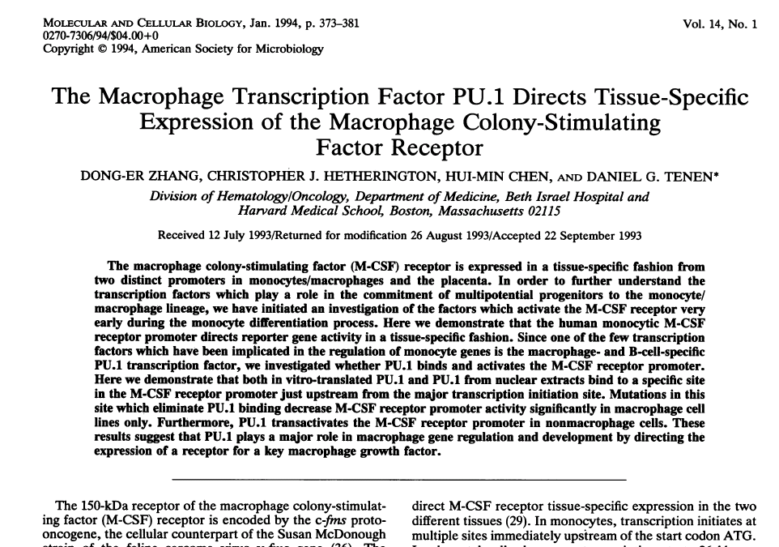
Domain: Biological publications

Slide 5
Problem: Named entity recognition (NER)
Protein-name extraction

Slide 6
Overview
What we are able to do:
  Train on large, labeled data sets drawn from same distribution as testing data
What we would like to be able do:
  Make learned classifiers more robust to shifts in domain and task
    Domain: Distribution from which data is drawn: e.g. abstracts, e-mails, etc
    Task: Goal of learning problem; prediction type: e.g. proteins, people
How we plan to do it:
  Leverage data (both labeled and unlabeled) from related domains and tasks
      Target: Domain/task we’re ultimately interested in
        data scarce and labels are expensive, if available at all
      Source: Related domains/tasks
        lots of labeled data available
  Exploit stable regularities and complex relationships between different aspects of that data

Slide 7
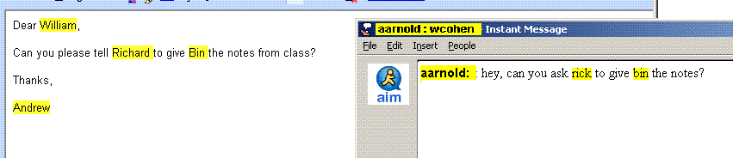
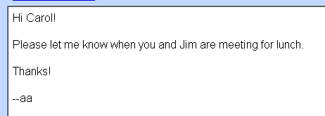
What we are able to do:
Supervised, non-transfer learning
  Train on large, labeled data sets drawn from same distribution as testing data
  Well studied problem
Training data:
Test:
Test:
Train:
Reversible histone acetylation changes the chromatin structure and can modulate gene transcription. Mammalian histone deacetylase 1 (HDAC1)
The neuronal cyclin-dependent kinase p35/cdk5 comprises a catalytic subunit (cdk5) and an activator subunit (p35)

Slide 8
What we would like to be able to do:
Transfer learning (domain adaptation):
  Leverage large, previously labeled data from a related domain
    Related domain we’ll be training on (with lots of data): Source
    Domain we’re interested in and will be tested on (data scarce): Target
      [Ng ’06, Daumé ’06, Jiang ’06, Blitzer ’06, Ben-David ’07, Thrun ’96]
Train (source domain: E-mail):
Test (target domain: IM):
Test (target domain: Caption):
Train (source domain: Abstract):
Neuronal cyclin-dependent kinase p35/cdk5 (Fig 1, a) comprises a catalytic subunit (cdk5, left panel) and an activator subunit (p35, fmi #4)
The neuronal cyclin-dependent kinase p35/cdk5 comprises a catalytic subunit (cdk5) and an activator subunit (p35)

Slide 9
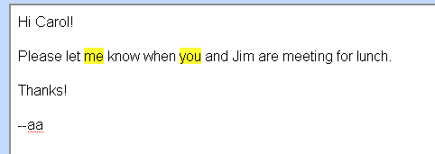
What we’d like to be able to do:
Transfer learning (multi-task):
    Same domain, but slightly different task
    Related task we’ll be training on (with lots of data): Source
    Task we’re interested in and will be tested on (data scarce): Target
      [Ando ’05, Sutton ’05]
Train (source task: Names):
Test (target task: Pronouns):
Test (target task: Action Verbs):
Train (source task: Proteins):
Reversible histone acetylation changes the chromatin structure and can modulate gene transcription. Mammalian histone deacetylase 1 (HDAC1)
The neuronal cyclin-dependent kinase p35/cdk5 comprises a catalytic subunit (cdk5) and an activator subunit (p35)

Slide 10
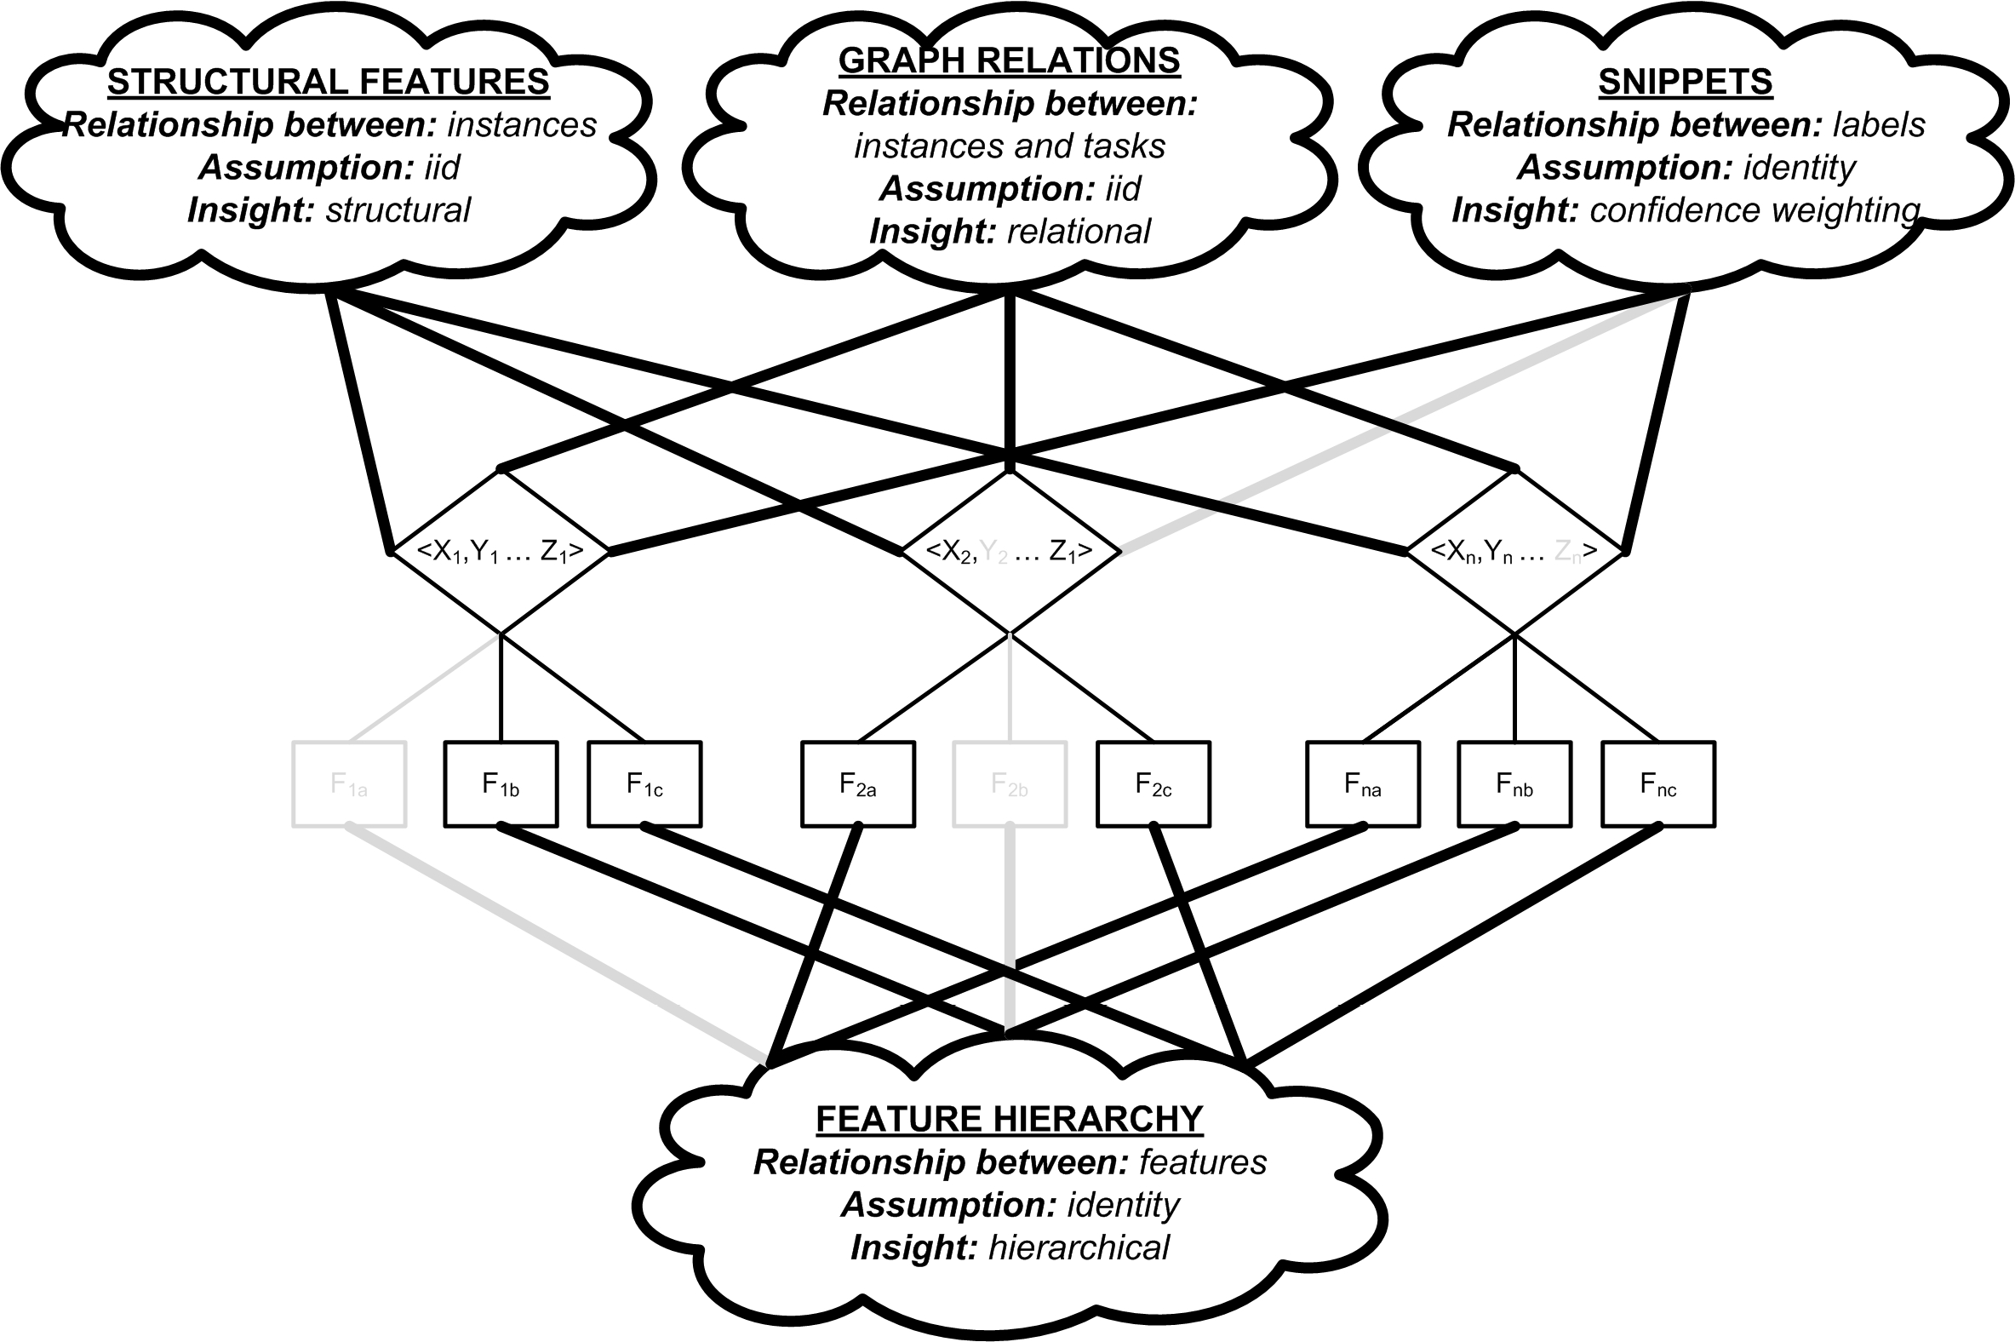
How we’ll do it: Relationships

Slide 11
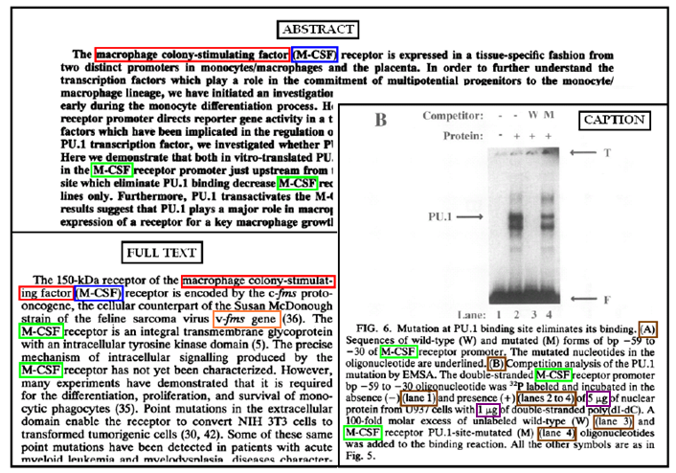
How we’ll do it: Related tasks
full protein name
abbreviated protein name
parenthetical abbreviated protein name
Image pointers (non-protein parenthetical)
      genes
      units

Slide 12
Motivation
Why is robustness important?
  Often we violate non-transfer assumption without realizing. How much data is truly identically distributed (the i.d. from i.i.d.)?
    E.g. Different authors, annotators, time periods, sources
Why are we ready to tackle this problem now?
  Large amounts of labeled data & trained classifiers already exist
    Can learning be made easier by leveraging related domains and tasks?
    Why waste data and computation?
Why is structure important?
  Need some way to relate different domains to one another, e.g.:
    Gene ontology relates genes and gene products
    Company directory relates people and businesses to one another

Slide 13
Outline
Overview
  Thesis, problem definition, goals and motivation
Contributions:
  Feature hierarchies
  Structural frequency features
  Snippets
  Graph relations
Conclusions & future work

Slide 14
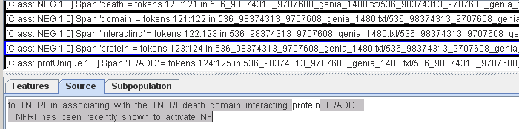
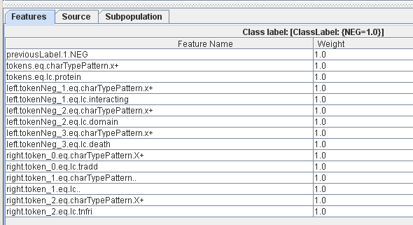
State-of-the-art features: Lexical

Slide 15
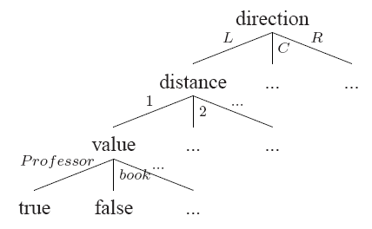
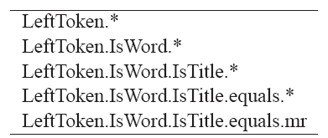
Feature Hierarchy
(Arnold, Nallapati and Cohen, ACL 2008)
Sample sentence:
Give the book to Professor Caldwell
Examples of the feature hierarchy: Hierarchical feature tree for ‘Caldwell’:

Slide 16
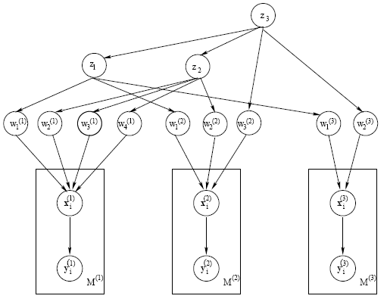
Hierarchical prior model (HIER)
Top level: z, hyperparameters, linking related features
Mid level: w, feature weights per each domain
Low level: x, y, training data:label pairs for each domain

Slide 17
Relationship: feature hierarchies

Slide 18
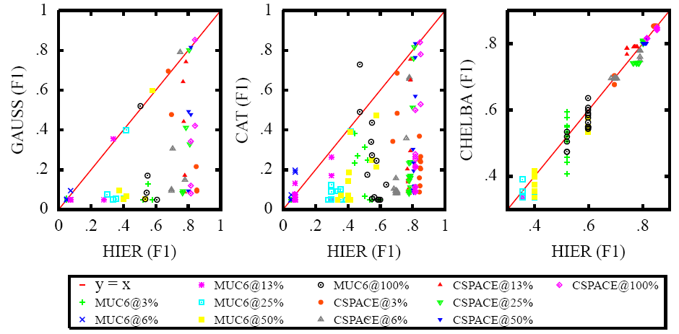
Results: Baselines vs. HIER
  Points below Y=X indicate HIER outperforming baselines
    HIER dominates non-transfer methods (GUASS, CAT)
    Closer to non-hierarchical transfer (CHELBA), but still outperforms

Slide 19
Conclusions
Hierarchical feature priors successfully
  exploit structure of many different natural language feature spaces
  while allowing flexibility (via smoothing) to transfer across various distinct, but related domains, genres and tasks
New Problem:
  Exploit structure not only in features space, but also in data space
    E.g.: Transfer from abstracts to captions of papers From Headers to Bodies of e-mails

Slide 20
Outline
Overview
  Thesis, problem definition, goals and motivation
Contributions:
  Feature hierarchies
  Structural frequency features
  Snippets
  Graph relations
Conclusions & future work

Slide 21
Transfer across document structure:
Abstract: summarizing, at a high level, the main points of the paper such as the problem, contribution, and results.
Caption: summarizing the figure it is attached to. Especially important in biological papers (~ 125 words long on average).
Full text: the main text of a paper, that is, everything else besides the abstract and captions.

Slide 22
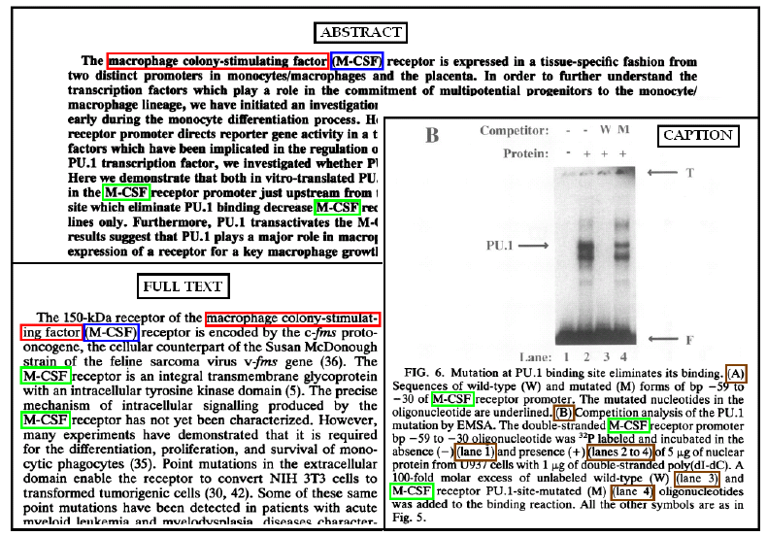
Sample biology paper
full protein name (red),
abbreviated protein name (green)
parenthetical abbreviated protein name (blue)
non-protein parentheticals (brown)

Slide 23
Structural frequency features
(Arnold and Cohen, CIKM 2008)
Insight: certain words occur more or less often in different parts of document
  E.g. Abstract: “Here we”, “this work”
  Caption: “Figure 1.”, “dyed with”
Can we characterize these differences?
  Use them as features for extraction?

Slide 24
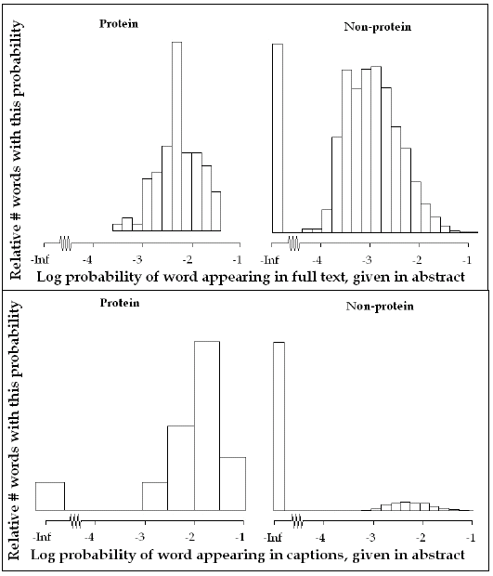
YES! Characterizable difference between distribution of protein and non-protein words across sections of the document

Slide 25
Relationship: intra-document structure

Slide 26
Outline
Overview
  Thesis, problem definition, goals and motivation
Contributions:
  Feature hierarchies
  Structural frequency features
  Snippets
  Graph relations
Conclusions & future work

Slide 27
Snippets
(Arnold and Cohen, CIKM 2008)
Tokens or short phrases taken from one of the unlabeled sections of the document and added to the training data, having been automatically positively or negatively labeled by some high confidence method.
  Positive snippets:
    Match tokens from unlabelled section with labeled tokens
    Leverage overlap across domains
    Relies on one-sense-per-discourse assumption
    Makes target distribution “look” more like source distribution
  Negative snippets:
    High confidence negative examples
    Gleaned from dictionaries, stop lists, other extractors
    Helps “reshape” target distribution away from source

Slide 28
Relationship: high-confidence predictions

Slide 29
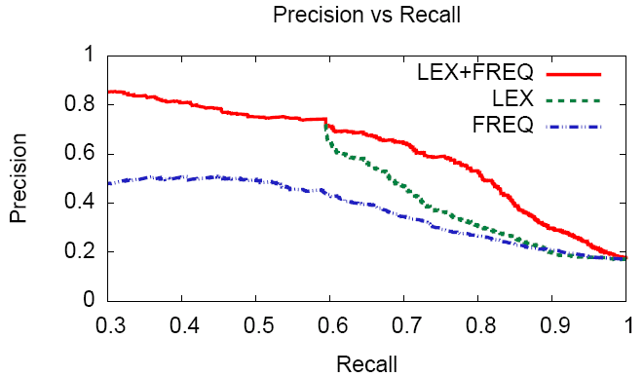
Performance: abstract → abstract
Precision versus recall of extractors trained on full papers and evaluated on abstracts using models containing:
  only structural frequency features (FREQ)
  only lexical features (LEX)
  both sets of features (LEX+FREQ).

Slide 30
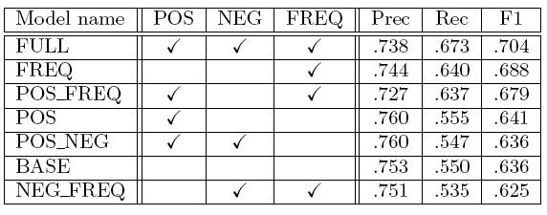
Performance: abstract → abstract
Ablation study results for extractors trained on full papers and evaluated on abstracts
  POS/NEG = positive/negative snippets

Slide 31
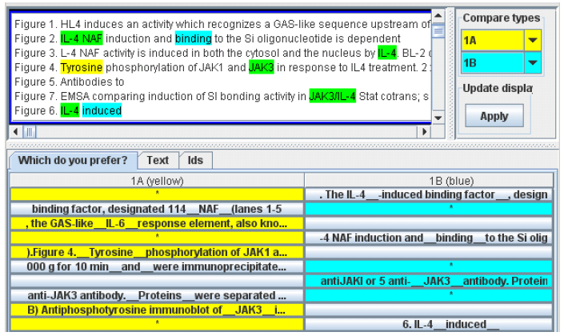
Performance: abstract →captions
How to evaluate?
  No caption labels
  Need user preference study:
Users preferred full (POS+NEG+FREQ) model’s extracted proteins over baseline (LEX) model (p = .00036, n = 182)

Slide 32
Outline
Overview
  Thesis, problem definition, goals and motivation
Contributions:
  Feature hierarchies
  Structural frequency features
  Snippets
  Graph relations
Conclusions & future work

Slide 33
Graph relations
(Arnold and Cohen, ICWSM, SNAS 2009)
Represent data and features as a graph:
  Nodes represent:
    Entities we are interested in:
      E.g. words, papers, authors, years
  Edges represent:
    Properties of and relationships between entities
      E.g. isProtein, writtenBy, yearPublished
Use graph-learning methods to answer queries
  Redundant/orthogonal graph relations provide robust structure across domains

Slide 34
Relations
  Mentions: paper→protein
  Authorship: author→paper
  Citation: paper→paper
  Interaction: gene→gene

Slide 35

Relation: Mention (paper→protein)

Slide 36
Relation: Authorship (author→paper)

Slide 37
Relation: Citation (paper→paper)

Slide 38
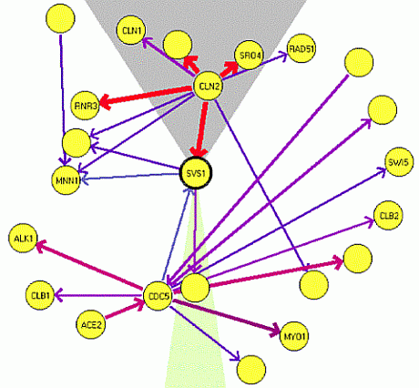
Relation: Interaction (gene→gene)

Slide 39
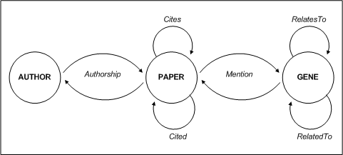
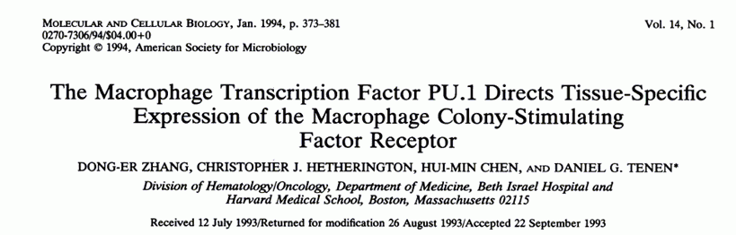
All together: curated citation network

Slide 40
Data
  PubMed
    Free, on-line archive
    Over 18 million biological abstracts published since 1948
      Including author list
  PubMed Central (PMC)
    Subset of above papers for which full-text is available
      Over one million papers
        Including: abstracts, full text and bibliographies
  The Saccharomyces Genome Database (SGD)
    Curated database of facts about yeast
      Over 40,000 papers manually tagged with associated genes
  The Gene Ontology (GO):
    Ontology describing properties of and relationships between various biological entities across numerous organisms

Slide 41
Nodes
The nodes of our network represent the entities we are interested in:
  44,012 Papers
    contained in SGD for which PMC bibliographic data is available.
  66,977 Authors of those papers
    parsed from the PMC citation data.
    Each author’s position in the paper’s citation (i.e. first author, last author, etc.) is also recorded.
  5,816 Genes of yeast, mentioned in those papers

Slide 42
Edges
We likewise use the edges of our network to represent the relationships between and among the nodes, or entities.
  Authorship: 178,233 bi-directional edges linking author nodes and the nodes of the papers they authored.
  Mention: 160,621 bi-directional edges linking paper nodes and the genes they discuss.
  Cites: 42,958 uni-directional edges linking nodes of citing papers to the nodes of the papers they cite.
  Cited: 42,958 uni-directional edges linking nodes of cited papers to the nodes of the papers that cite them
  RelatesTo: 1,604 uni-directional edges linking gene nodes to the nodes of other genes appearing in their GO description.
  RelatedTo: 1,604 uni-directional edges linking gene nodes to the nodes of other genes in whose GO description they appear.

Slide 43
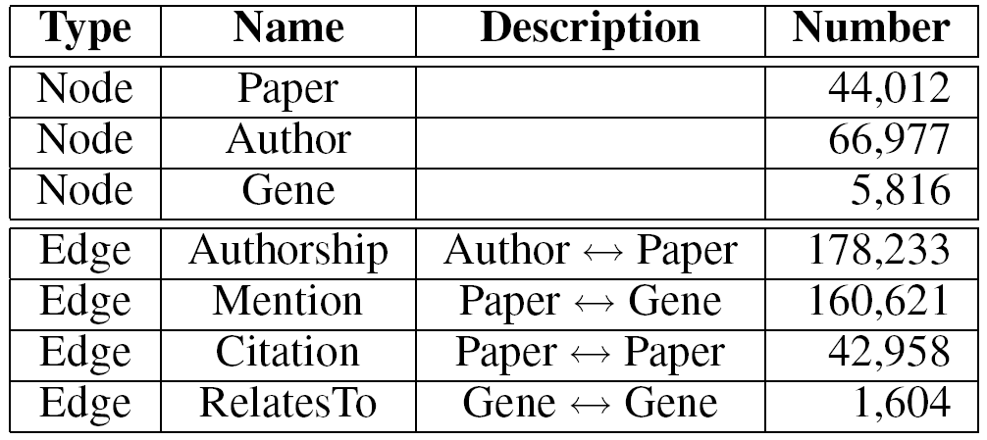
Graph summary

Slide 44
Problem
Predict which genes and proteins a biologist is likely to write about in the future
Using:
  Information contained in publication networks
  Information concerning an individual’s own publications
  No textual information (for now)
Model as link prediction problem:
  From: protein extraction
    P(token is a protein | token properties)
  To: link prediction
    P(edge between gene and author| relation network)

Slide 45
More generally: Link prediction
Given: historical curated citation network
  And: author/paper/gene query
    Predict: distribution over related authors/papers/genes
      Interpretation: related entities more likely to be written about

Slide 46
Method
How to find related entities in graph?
  Walk!
    Intuitively:
      Start at query nodes
      For search depth:
        Simultaneously follow each out-edge with probability inversely proportional to current node’s total out-degree
      At end of walk, return list of nodes, sorted by fraction of paths that end up on that node
    Practically:
      Power method:
        Exponentiate adjacency matrix

Slide 47
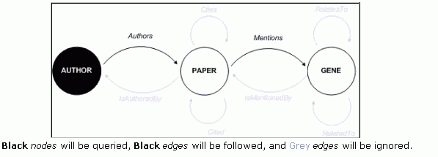
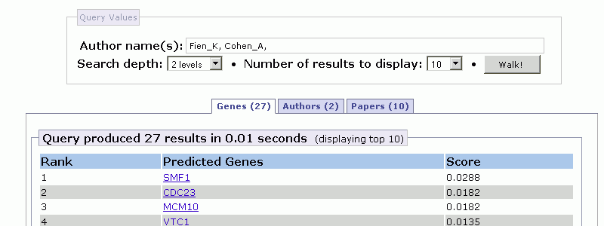
Example

Slide 48
Questions
Which, if any, relations are most useful?
  We can choose to ignore certain edge/node types in our walk
    Compare predictive performance of various networks ablated in different ways
  Protocol:
    Given: set of authors who published in 2007+2008
    And: Pre-2008 curated citation network
    Predict: New genes authors will write about in 2008
How much can a little information help?
  We can selectively add one known 2008 gene to the query and see how much it helps

Slide 49
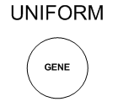
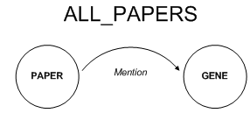
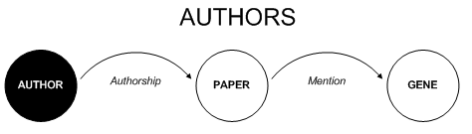
Ablated networks: Baselines

Slide 50
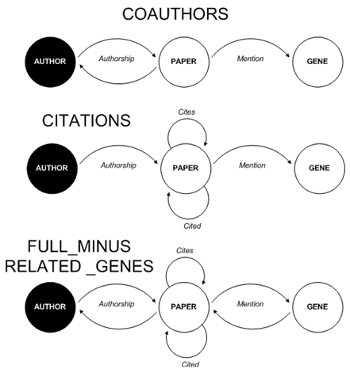
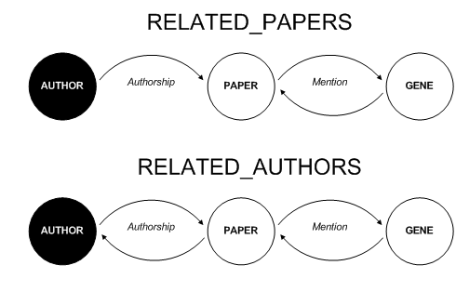
Ablated networks: Social

Slide 51
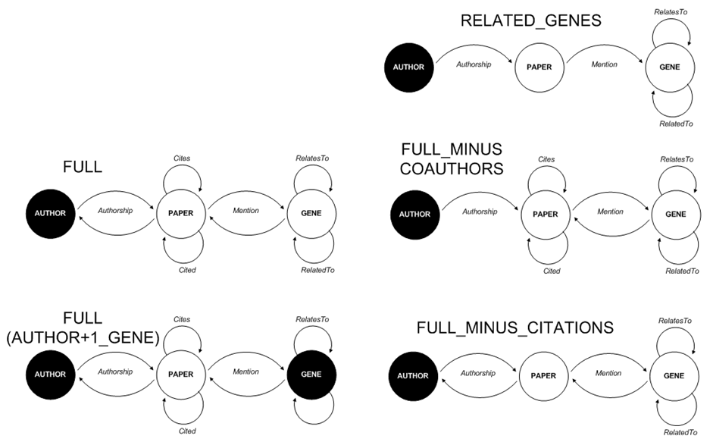
Ablated networks: Social + Biological

Slide 52
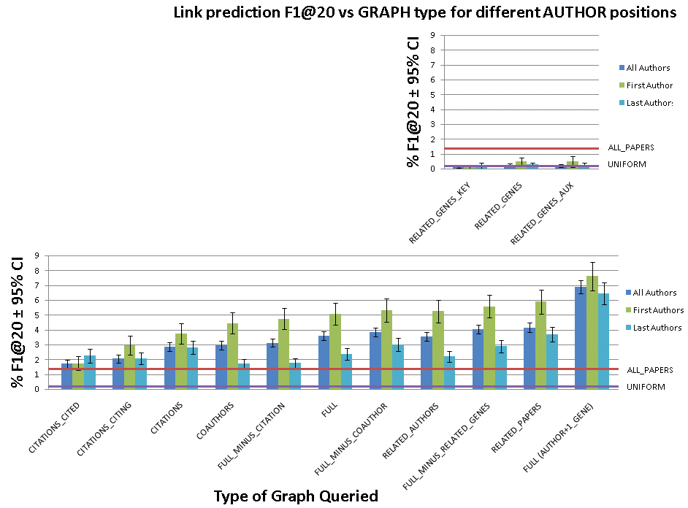
Results:
  First author most predictive
    Except: CITATIONS_CITED
  Pure bio models do poorly
    On par with worst baseline
    Full model benefits from removing bio relations

Slide 53
Results:
  Social models beat baselines
    Simple collaborative filtering RELATED_PAPERS does best*
  FULL model benefits slightly* from removing coauthorship relations
  Adding 1_GENE helps a lot
    50% better than FULL
    Significantly* better than second best RELATED_PAPERS

Slide 54
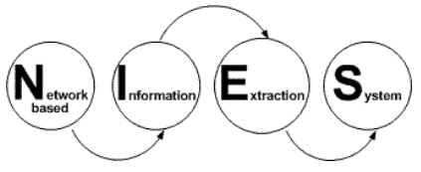
On-line demo
Web application implementing our algorithm
  Includes links to data files
  http://yeast.ml.cmu.edu/nies

Slide 55
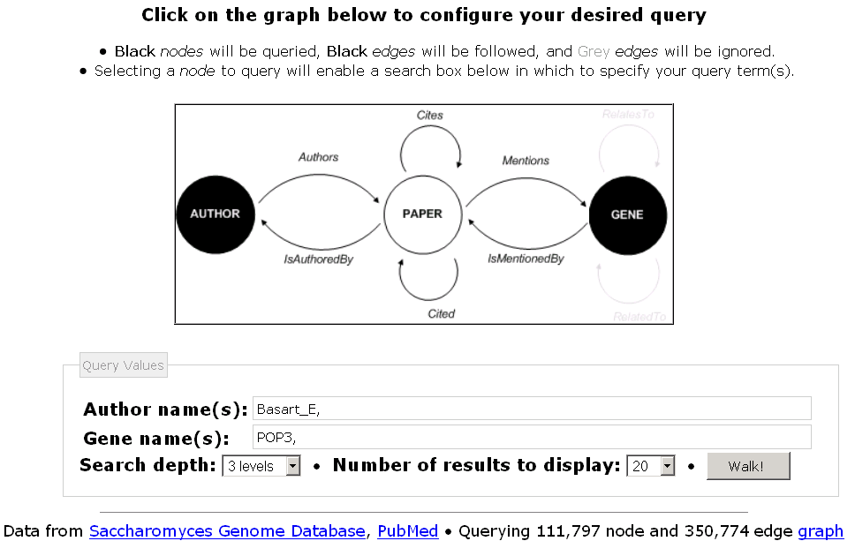

Slide 56
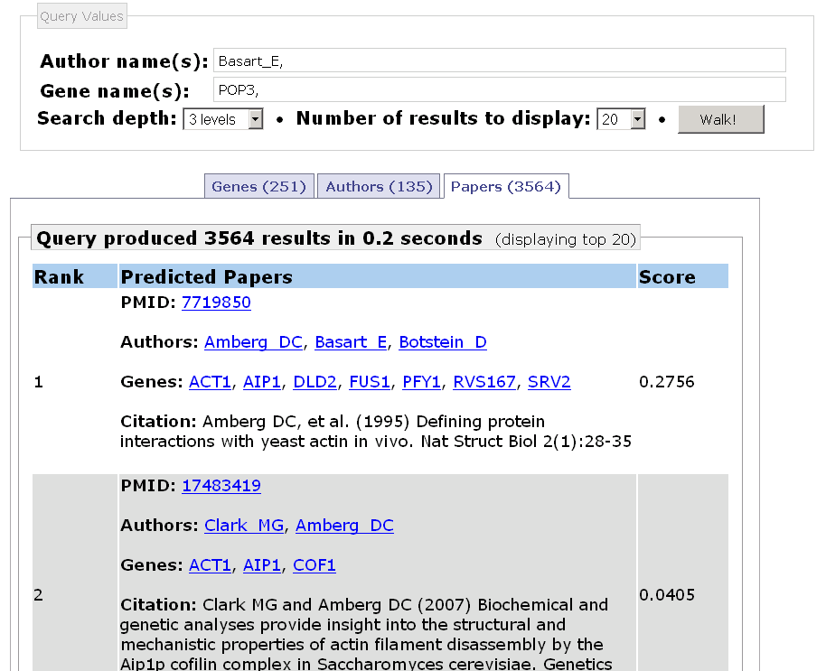

Slide 57
Graph-based priors for named entity extraction
Social network features are informative but…
  Do they replace lexical features (i.e. redundant)?
  Or supplement them (i.e. orthogonal)?
Combine network relations with lexical features
  More robust model built from different views of data

Slide 58
Method
How to combine these two representations:
  Graph-based social features
  Vector-based lexical features
Use ranked predictions made by curated citation network as features in standard lexical classifier:
  Query each test paper’s authors against citation graph
    Return ranked list of genes
    Add top-k genes to a dictionary of ‘related genes’
  For each token in the paper
    Test membership of token in ‘related genes’ dictionary
    Use membership as feature in classifier, along with lexical features

Slide 59
Experiment
Evaluate contribution of curated citation network features to standard lexical-feature-based CRF extractor
  Split data train/test
    298 GENIA abstracts with PMC, SGD and GO data
    (method requires labeled abstracts and citation information)
  Compare performances of two trained models:
    CRF_LEX: standard CRF model trained on lexical features
    CRF_LEX+GRAPH_SUPERVISED: standard CRF model trained on lexical features, augmented with curated citation network based features (i.e., membership in dictionaries of ‘related genes’)

Slide 60
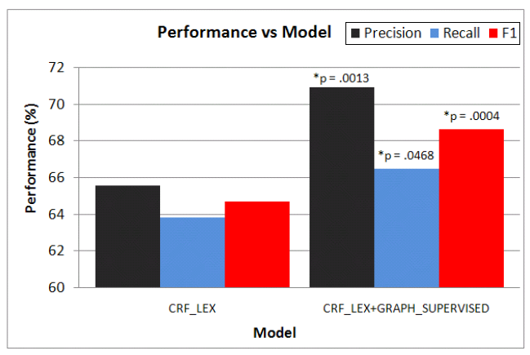
Results
Adding graph-relations to lexical model improves performance
  CRF_LEX+GRAPH_SUPERVISED > CRF_LEX

Slide 61
Graph relations conclusions & future work
Graphs offer natural way to integrate disparate sources of information
Network-based social features alone can do well
  Significant predictive information in these relations
  Improved by combining with lexical features
Social knowledge often trumps biological input
  What other types of relations can we try?
    Sub-structure of a document (abstract, captions, etc)?
First authors are most predictive
  What other social hypotheses can we test? Impact factor?
We can leverage high confidence predictions to improve overall performance
  What other types of leverage can we find:
    Collective classification?
    Transfer across domains, document sections, organisms?

Slide 62
Outline
Overview
  Thesis, problem definition, goals and motivation
Contributions:
  Feature hierarchies
  Structural frequency features
  Snippets
  Graph relations
Conclusions & future work

Slide 63
Conclusions
Robust learning across domains is possible but requires some other type of information joining the two domains:
Linguistically-inspired feature hierarchies:
  Exploit hierarchical relationship between lexical features
  Allow for natural smoothing and sharing of information across features
Structural frequency features take advantage of the information in:
  Structure of data itself
  Distribution of instances across that structure
    (e.g. words across the sections of an article)
Snippets leverage the relationship of entities:
  Among themselves
  Across tasks and labels within a dataset.
Graph relations allow us to tie together:
  Disparate entities and sources of data
    Lets brittleness in one task be supported by robustness from another

Slide 64
Future work
Hierarchical feature models
  Other models besides linguistic hierarchy
    Correlation between features
Snippets
  Other ways of grouping besides exact match
    Back-off tree based matching
    Edit distance
  Other positive and negative heuristics
    Better task-specific classifiers
    Better domain-specific taxonomies and grammars
Graphical relations:
  Incorporate temporal information
  Represent structure of document text itself as graph
  Full transfer experiment

Slide 65
☺ ¡Thank you! ☺
No, really, thank you all…
¿ Questions ?
For details and references please see thesis document:
  http://www.cs.cmu.edu/~aarnold/thesis/aarnold_thesis_v8.pdf

